Slide 1
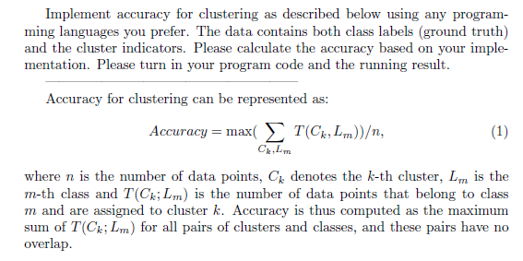
Due: 11/30/2016

